Slide 1
Individually Randomized Designs
Larry V. Hedges
Northwestern University
Presented at the NSF Institute on Improving the Design of Evaluation studies in STEM Education Research, July 20, 2021

Slide 2
Varieties of Randomized Experiments
There are a huge variety of experimental designs that involve randomization
Designs can differ in terms of:
1. What is randomized (individuals, groups, etc.)
2. How the data is organized before randomization (subdivided in some ways, counterbalanced, etc.)
3. How the data is sampled
4. How or if matching is used
5. How or if statistical controls are used

Slide 3
Definition of Individually Randomized Designs
In an individually randomized design, some sample of individuals (not groups) is randomly assigned to treatment or a control condition
Sample
Equal numbers are often assigned to each group
Assignment of unequal numbers to each group is also possible
But the key principle is that assignment is at random
Haphazard or unknown assignment is not random assignment
Intervention
Comparison

Slide 4
Examples
We have 100 students in a school, we assign 50 at random to get the treatment (and after school enrichment program) and the other 50 serve as “no treatment” controls
We have 50 teachers in a school district, we assign 20 at random to get the treatment (a professional development program) and the other 80 serve as “no treatment” controls
There are 30 students in a (large) classroom. We randomly assign 15 students to work with one biology curriculum and 15 students to work with a different biology curriculum
There are 25 students in a classroom. We randomly assign 2 students to take a “pull out” supplementary math program. The other 23 students serve as controls.

Slide 5
Examples
We have 100 students in a school, we assign 50 at random to get the treatment (and after school enrichment program) and the other 50 serve as “no treatment” controls
We have 50 teachers in a school district, we assign 20 at random to get the treatment (a professional development program) and the other 80 serve as “no treatment” controls
There are 30 students in a (large) classroom. We randomly assign 15 students to work with one biology curriculum and 15 students to work with a different curriculum
There are 25 students in a classroom. We randomly assign 2 students to take a “pull out” supplementary math program. The other 23 students serve as controls
We have been working with 5 students in a cognitive lab. We assign 3 students to get a modification of the technology we have been using and the other 2 students work with the old version of the technology

Slide 6
Are These Examples of Random Assignment?
We have a list of 100 students in a school. We assign 50 students with odd numbers (1st, 3rd, 5th, etc.) to get the treatment (and after school enrichment program) and the other 50 (with even numbers) serve as “no treatment” controls
We have a list of 100 students in a school. For each student, we flip a coin and assign the student to the treatment group is a heads comes up. We stop when we have assigned 50 to the treatment
We have 50 students in a school and two curricula (earth science and biology). We assign 25 students to receive earth science first semester (biology the second) by flipping a coin as above. The other students get biology in the first semester (earth science the second). The outcome is an end of first semester test
In the last example, what if we evaluated the outcome after the second semester.

Slide 7
The Treatment Contrast
Treatment effects are contrasts between two things
The very idea of “treatment effect” is meaningless without have in mind some other (counterfactual) condition
Recall that the definition of causal effect of a treatment on an outcome is the difference between the outcome that would be observed if the individual got the treatment and the outcome if they receive some other (comparison) condition
This is called a counterfactual definition of causal effect because individuals cannot receive both the treatment condition and the comparison condition

Slide 8
The Treatment Contrast
What is the treatment contrast in each of these:
We have 100 students in a school, we assign 50 at random to get the treatment (and after school enrichment program) and the other 50 serve as “no treatment” controls
There are 30 students in a (large) classroom. We randomly assign 15 students to work with one biology curriculum and 15 students to work with a different curriculum
There are 25 students in a classroom. We randomly assign 2 students to take a “pull out” supplementary math program. The other 23 students serve as controls
We have been working with 5 students in a cognitive lab. We assign 3 students to get a modification of the technology we have been using and the other 2 students work with the old version of the technology

Slide 9
The Treatment Contrast
What is the treatment contrast in these examples:
We have 50 students in a school and two curricula (earth science and biology). We assign 25 students to receive earth science first semester (biology the second) by flipping a coin as above. The other students get biology in the first semester (earth science the second). The outcome is an end of first semester test
In the last example, what if we evaluated the outcome after the second semester.

Slide 10
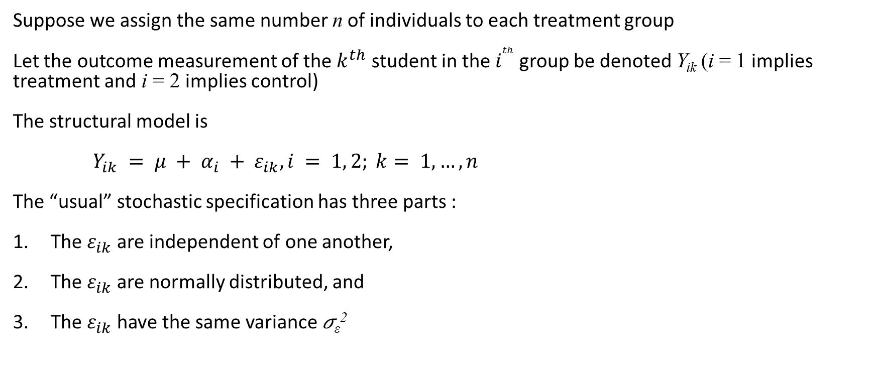
A Statistical Model
Suppose we assign the same number n of individuals to each treatment group
Let the outcome measurement of the $k^{th}$ student in the $i^{th}$ group be denoted Y_{ik} (i = 1 implies treatment and i = 2 implies control)
The structural model is
$Y_{ik} = μ + α_{i} + ε_{ik}, i = 1, 2; k= 1, …, n$
The “usual” stochastic specification has three parts :
The $ε_{ik}$ are independent of one another,
The $ε_{ik}$ are normally distributed, and
The $ε_{ik}$ have the same variance 𝜎_{ε}²

Slide 11
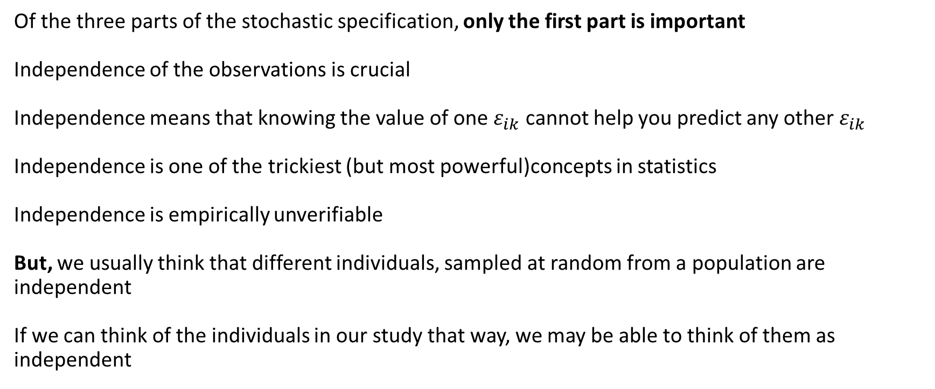
The Stochastic Specification
Of the three parts of the stochastic specification, only the first part is important
Independence of the observations is crucial
Independence means that knowing the value of one $ε_{ik}$ cannot help you predict any other $ε_{ik}$
Independence is one of the trickiest (but most powerful)concepts in statistics
Independence is empirically unverifiable
But, we usually think that different individuals, sampled at random from a population are independent
If we can think of the individuals in our study that way, we may be able to think of them as independent

Slide 12
Why Are the Other Two Assumptions Less Important
Consider this analysis of our experiment
Compute the difference between the mean of the treatment and control groups (the treatment effect) in our experiment
Take the Y_{ik}’s and make a list of every possible way that we could have assigned i =1 to n of them and i =2 to the other n outcomes (it would be long list)
Compute the difference between the mean of the treatment and control groups (the treatment effect) in every one of the possible assignments on our long list
Compare the treatment effect we observed to the list (the distribution) of treatment effects that might have been observed with all the different possible treatment assignments to the observed outcomes
Believe the treatment effect is real if the observed treatment effect is unusual among all possible treatment effects (with different assignments)

Slide 13
Why Are the Other Two Assumptions Less Important
The process I just described is called a randomization test. It makes no assumptions except independence
R. A. Fisher, the father of randomized experiments, proposed the randomization test as a way to analyze experimental data (The Lady Tasting Tea allegory)
What is surprising and completely non-obvious is that the statistical methods we will talk about are known (via the theory of mathematical statistics) to be very good approximations to randomization tests
That means that the other two pats of the stochastic model are not terribly important

Slide 14
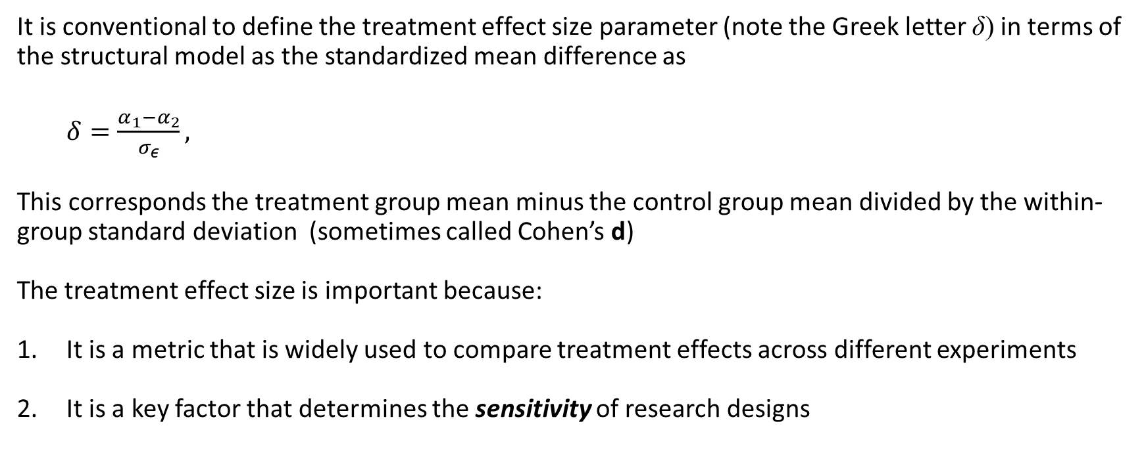
Effect Size
It is conventional to define the treatment effect size parameter (note the Greek letter δ) in terms of the structural model as the standardized mean difference as
$δ=\frac{α_{1}−α_{2}}{σ_{ε}},$
This corresponds the treatment group mean minus the control group mean divided by the within-group standard deviation (sometimes called Cohen’s d)
The treatment effect size is important because:
It is a metric that is widely used to compare treatment effects across different experiments
It is a key factor that determines the sensitivity of research designs

Slide 15
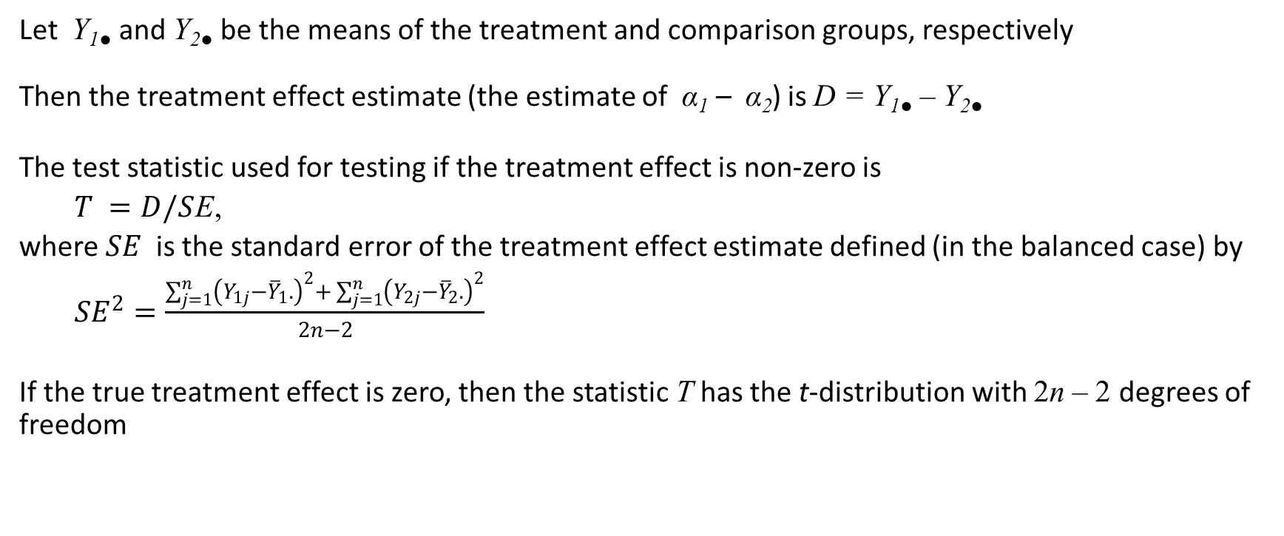
Testing the Significance of the Treatment Effect
Let Y_{1●} and Y_{2●} be the means of the treatment and comparison groups, respectively
Then the treatment effect estimate (the estimate of α₁ – α₂) is D = Y_{1●} – Y_{2●}
The test statistic used for testing if the treatment effect is non-zero is
$T =D/S$E,
where $SE$is the standard error of the treatment effect estimate defined (in the balanced case) by ${SE}^{2}=\frac{\sum_{j=1}^{n}{{\left(Y_{1j}−{\overline{Y}}_{1}.\right)}^{2}+ \sum_{j=1}^{n}{{\left(Y_{2j}−{\overline{Y}}_{2}.\right)}^{2}}}}{2n−2}$
If the true treatment effect is zero, then the statistic T has the t-distribution with 2n – 2 degrees of freedom

Slide 16
Testing the Significance of the Treatment Effect
The significance testing process involves
Picking a significance level (this is up to you, but 0.05 is a very strong convention)
Computing the value of T from the data
Obtaining the critical value of the t-distribution with 2n – 2 degrees of freedom (which will be about 2 for the for all but the smallest degrees of freedom)
Reject the null hypothesis of no treatment effect (in other words conclude that the treatment effect is significant) if |T| exceeds the critical value
You could also use software that computes the “exact p-value.” In that method, conclude that the treatment effect is significant if the two-tailed p-value is less than 0.05

Slide 17
Design Sensitivity
Recall that design sensitivity can be described in any one of three related ways:
Statistical power: The probability of detecting a given treatment effect size
Precision (standard error) of the estimated treatment effect: The uncertainty (margin of error) of the estimated treatment effect
The minimum detectable effect size (MDES): The smallest effect size that can be detected with a given statistical power
Design sensitivity depends on the research design
We plan a design to have adequate sensitivity so that the results of the study will be conclusive

Slide 18
Design Sensitivity
Why is design sensitivity important?
Consider a study that has low power (say 0.4) to detect the treatment effect size you expect
If you detect the effect (find that the treatment effect is statistically significant), the study is conclusive
But if you do not find a significant effect,
it could be because the treatment has no effect or
because the treatment produced the expected effect but was not detected
Moreover, if the power is 0.4, it mans that there is a 60% chance you will fail to find the effect if it is there—nonsignificant effects are more likely than significant effects

Slide 19
Statistical Power
Recall that statistical power is the chance that the statistical test will decide that the treatment effect is significant—it is the chance that the test will detect a nonzero effect if it exists
Statistical power depends on:
The significance level (0.05 is a very strong convention)
The type of design
The sample sizes
The effect sizes
In some designs, there are other design parameters
A strong convention is that power of 0.8 (80%) is adequate for planning designs

Slide 20
Precision
The precision (standard error of the estimated treatment effect size) depends on:
The type of design
The sample sizes
In some designs, other design parameters
Note that precision does not depend on the treatment effect size

Slide 21
Minimum Detectable Effect Size (MDES)
Minimum detectable effect size depends on:
The significance level (0.05 is a very strong convention)
The power level desired (0.8 is a strong convention)
The type of design
The sample sizes
In some designs, there are other design parameters
Note that MDES does not depend on the effect size

Slide 22
Statistical Power as a Function of n and Effect Size δ
 | δ
n | 0.1 | 0.2 | 0.3 | 0.4 | 0.5 | 0.6 | 0.7 | 0.8 | 0.9 | 1 | 1.5
10 | 0.06 | 0.07 | 0.10 | 0.14 | 0.19 | 0.25 | 0.32 | 0.40 | 0.48 | 0.56 | 0.89
20 | 0.06 | 0.10 | 0.15 | 0.23 | 0.34 | 0.46 | 0.58 | 0.69 | 0.79 | 0.87 | 1
30 | 0.07 | 0.12 | 0.21 | 0.33 | 0.48 | 0.63 | 0.76 | 0.86 | 0.93 | 0.97 | 1
40 | 0.07 | 0.14 | 0.26 | 0.42 | 0.60 | 0.75 | 0.87 | 0.94 | 0.98 | 0.99 | 1
50 | 0.08 | 0.17 | 0.32 | 0.51 | 0.70 | 0.84 | 0.93 | 0.98 | 0.99 | 1 | 1
60 | 0.08 | 0.19 | 0.37 | 0.58 | 0.78 | 0.90 | 0.97 | 0.99 | 1 | 1 | 1
70 | 0.09 | 0.22 | 0.42 | 0.65 | 0.84 | 0.94 | 0.98 | 1 | 1 | 1 | 1
80 | 0.10 | 0.24 | 0.47 | 0.71 | 0.88 | 0.96 | 0.99 | 1 | 1 | 1 | 1
90 | 0.10 | 0.27 | 0.52 | 0.76 | 0.92 | 0.98 | 1 | 1 | 1 | 1 | 1
100 | 0.11 | 0.29 | 0.56 | 0.80 | 0.94 | 0.99 | 1 | 1 | 1 | 1 | 1
150 | 0.14 | 0.41 | 0.74 | 0.93 | 0.99 | 1 | 1 | 1 | 1 | 1 | 1
200 | 0.17 | 0.51 | 0.85 | 0.98 | 1 | 1 | 1 | 1 | 1 | 1 | 1
500 | 0.35 | 0.89 | 1 | 1 | 1 | 1 | 1 | 1 | 1 | 1 | 1

Slide 23
Minimum Detectable Effect Size as a Function of n
n | MDES
10 | 1.33
20 | 0.91
30 | 0.74
40 | 0.64
50 | 0.57
60 | 0.52
70 | 0.48
80 | 0.45
90 | 0.42
100 | 0.40
150 | 0.32
200 | 0.28
500 | 0.18

Slide 24
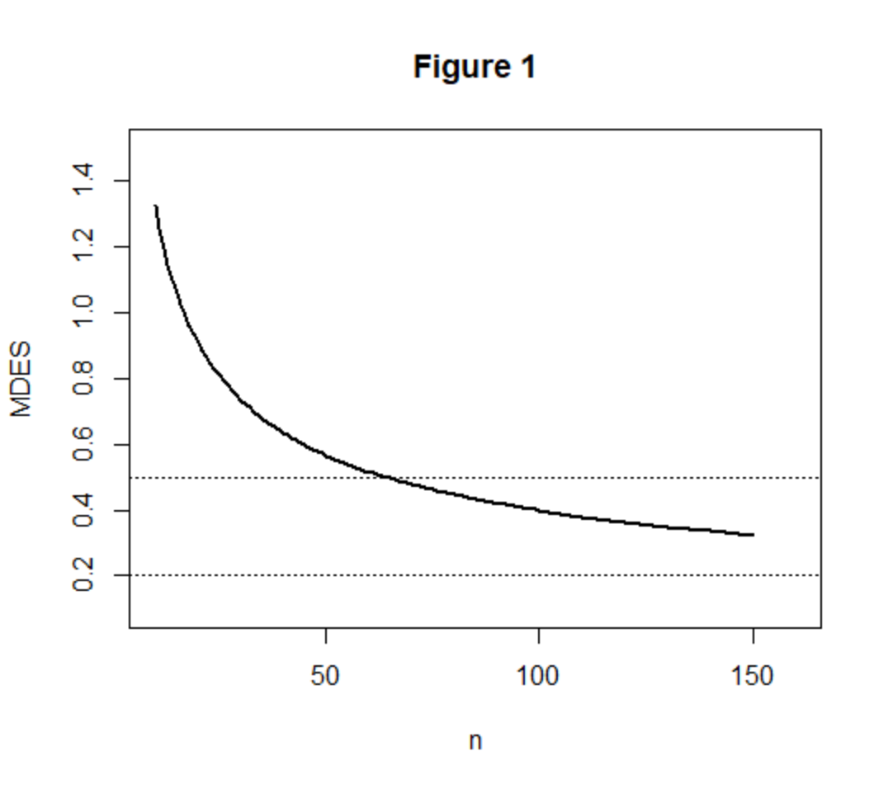
A Graphical Representation of MDES as a Function of n

Slide 25
MDES is Easy to Use in Planning Designs
Calculating statistical power requires selecting an effect size in advance and then finding a sample size that yields adequate power
Precision is simpler than power, but if we are concerned about getting statistically significant results, precision is indirect
Minimum detectable effect size makes it easy to find the sample size that can detect an effect of the size you expect

Slide 26
The Fundamental Problem of Research Design
The fundamental problem of research design is how to plan a feasible design that is adequately sensitive
If you have unlimited sample size, it is easy to get any design sensitivity you want
But we never have access to an unlimited sample size
Especially in development studies, we are usually limited to a small number of schools or classes (10 or less) and at most a few hundred students

Slide 27
How Do You Plan a Research Design?
Start with some notion of the effect size you expect
Then consider what sample of individuals you believe you could get to test the treatment
Are they grouped into schools or classrooms? Can they plausibly be considered independent?
Can they be assigned to treatments individually?
If not, then the individually randomized design cannot be used
In the easiest case, then you simply use a table like the one presented previously or a software tool and find the sample size that has an MDES that is smaller than the effect size you expect
Often, that sample size is larger than the sample you believe you could get
What then?

Slide 28
How Do You Plan a Research Design?
If the balanced design requires a bigger sample size than you believe you can get then:
You can get a bigger sample (it may just be a matter of trying harder)
Change the design (how you do this will depend on what is feasible)
Options for changing the design:
Use a covariate
Consider an unbalanced design
Consider a randomized block design (possibly with covariates)

Slide 29
Adding Covariates
A covariate is any variable whose value cannot be influenced by treatment assignment
Useful covariates are those that are correlated with the outcome
A pretest covering similar content is often a good covariate
The covariate does not need to measure the same things to be useful: All that matters is that it is correlated with the outcome
You do not need to have a theory of why the covariate is correlated with the outcome
Reading scores can be useful covariates for math and science outcomes and vice versa
Demographic variables (gender, ethnicity, SES) tend to be less useful as covariates than test scores

Slide 30
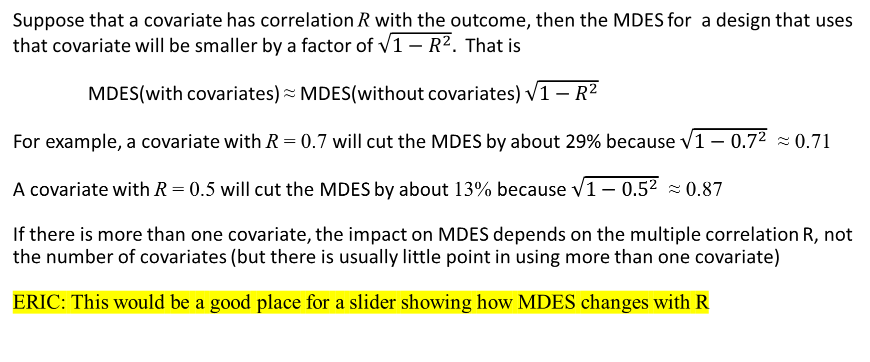
The Effect of Covariates on MDES
Suppose that a covariate has correlation R with the outcome, then the MDES for a design that uses that covariate will be smaller by a factor of $\sqrt{1−R^{2}}.$ That is
MDES(with covariates) ≈ MDES(without covariates) $\sqrt{1−R^{2}}$
For example, a covariate with R = 0.7 will cut the MDES by about 29% because $\sqrt{1−{0.7}^{2}}$ ≈ 0.71
A covariate with R = 0.5 will cut the MDES by about 13% because $\sqrt{1−{0.5}^{2}}$ ≈ 0.87
If there is more than one covariate, the impact on MDES depends on the multiple correlation R, not the number of covariates (but there is usually little point in using more than one covariate)
ERIC: This would be a good place for a slider showing how MDES changes with R

Slide 31
A Tabular Representation of the Influence of R on MDES
 | R
n | 0 | 0.1 | 0.2 | 0.3 | 0.4 | 0.5 | 0.6 | 0.7 | 0.8 | 0.9
10 | 1.33 | 1.32 | 1.30 | 1.27 | 1.22 | 1.15 | 1.06 | 0.95 | 0.80 | 0.58
20 | 0.91 | 0.91 | 0.89 | 0.87 | 0.83 | 0.79 | 0.73 | 0.65 | 0.55 | 0.40
30 | 0.74 | 0.73 | 0.72 | 0.70 | 0.68 | 0.64 | 0.59 | 0.53 | 0.44 | 0.32
40 | 0.64 | 0.63 | 0.62 | 0.61 | 0.58 | 0.55 | 0.51 | 0.45 | 0.38 | 0.28
50 | 0.57 | 0.56 | 0.56 | 0.54 | 0.52 | 0.49 | 0.45 | 0.40 | 0.34 | 0.25
60 | 0.52 | 0.51 | 0.51 | 0.49 | 0.47 | 0.45 | 0.41 | 0.37 | 0.31 | 0.23
70 | 0.48 | 0.48 | 0.47 | 0.46 | 0.44 | 0.41 | 0.38 | 0.34 | 0.29 | 0.21
80 | 0.45 | 0.44 | 0.44 | 0.43 | 0.41 | 0.39 | 0.36 | 0.32 | 0.27 | 0.20
90 | 0.42 | 0.42 | 0.41 | 0.40 | 0.38 | 0.36 | 0.34 | 0.30 | 0.25 | 0.18
100 | 0.40 | 0.40 | 0.39 | 0.38 | 0.36 | 0.34 | 0.32 | 0.28 | 0.24 | 0.17
150 | 0.32 | 0.32 | 0.32 | 0.31 | 0.30 | 0.28 | 0.26 | 0.23 | 0.20 | 0.14
200 | 0.28 | 0.28 | 0.28 | 0.27 | 0.26 | 0.24 | 0.22 | 0.20 | 0.17 | 0.12
500 | 0.18 | 0.18 | 0.17 | 0.17 | 0.16 | 0.15 | 0.14 | 0.13 | 0.11 | 0.08

Slide 32
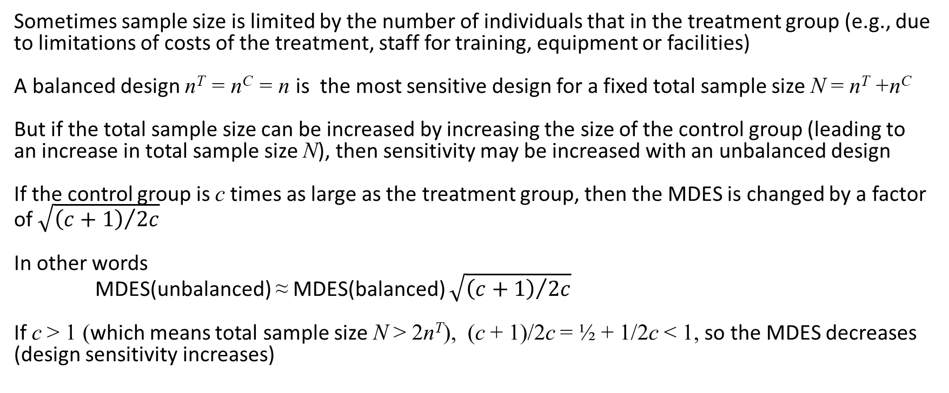
Unbalanced Designs
Sometimes sample size is limited by the number of individuals that in the treatment group (e.g., due to limitations of costs of the treatment, staff for training, equipment or facilities)
A balanced design n^{T} = n^{C} = n is the most sensitive design for a fixed total sample size N = n^{T} +n^{C}
But if the total sample size can be increased by increasing the size of the control group (leading to an increase in total sample size N), then sensitivity may be increased with an unbalanced design
If the control group is c times as large as the treatment group, then the MDES is changed by a factor of $\sqrt{{\left(c+1\right)}/{2c}}$
In other words
MDES(unbalanced) ≈ MDES(balanced) $\sqrt{{\left(c+1\right)}/{2c}}$
If c > 1 (which means total sample size N > 2n^{T}), (c + 1)/2c = ½ + 1/2c < 1, so the MDES decreases (design sensitivity increases)

Slide 33
Unbalanced Designs
Eric: This would be a good place for an insert of how increasing n^{C} (fixing n^{T}) deceases MDES
Note that the effect on MDES (design sensitivity) of increasing sample size of the control group are generally modest (except for the smallest treatment group sample sizes
Note that there is a point of diminishing returns, beyond which further increases have only negligible effects

Slide 34
A Tabular Representation of the Influence of Unbalanced Designs on MDES
 | Control group size: n^{C}
n^{T} | n^{T} | n^{T}+10 | n^{T}+20 | n^{T}+30 | n^{T}+40 | n^{T}+50 | n^{T}+75 | n^{T}+100 | n^{T}+150 | n^{T}+200 | n^{T}+500 | n^{T}+∞
10 | 1.32 | 1.12 | 1.05 | 1.01 | 0.99 | 0.97 | 0.95 | 0.93 | 0.92 | 0.91 | 0.90 | 0.89
20 | 0.91 | 0.83 | 0.78 | 0.75 | 0.73 | 0.72 | 0.70 | 0.68 | 0.67 | 0.66 | 0.64 | 0.63
30 | 0.74 | 0.69 | 0.66 | 0.63 | 0.62 | 0.61 | 0.58 | 0.57 | 0.56 | 0.55 | 0.53 | 0.51
40 | 0.64 | 0.60 | 0.58 | 0.56 | 0.55 | 0.54 | 0.52 | 0.51 | 0.49 | 0.48 | 0.46 | 0.44
50 | 0.57 | 0.54 | 0.52 | 0.51 | 0.50 | 0.49 | 0.47 | 0.46 | 0.44 | 0.44 | 0.42 | 0.40
60 | 0.52 | 0.50 | 0.48 | 0.47 | 0.46 | 0.45 | 0.44 | 0.43 | 0.41 | 0.40 | 0.38 | 0.36
70 | 0.48 | 0.46 | 0.45 | 0.44 | 0.43 | 0.42 | 0.41 | 0.40 | 0.39 | 0.38 | 0.36 | 0.34
80 | 0.45 | 0.43 | 0.42 | 0.41 | 0.41 | 0.40 | 0.39 | 0.38 | 0.36 | 0.36 | 0.34 | 0.31
90 | 0.42 | 0.41 | 0.40 | 0.39 | 0.39 | 0.38 | 0.37 | 0.36 | 0.35 | 0.34 | 0.32 | 0.30
100 | 0.40 | 0.39 | 0.38 | 0.38 | 0.37 | 0.36 | 0.35 | 0.34 | 0.33 | 0.32 | 0.30 | 0.28
150 | 0.32 | 0.32 | 0.32 | 0.31 | 0.31 | 0.30 | 0.30 | 0.29 | 0.28 | 0.27 | 0.26 | 0.23
200 | 0.28 | 0.28 | 0.28 | 0.27 | 0.27 | 0.27 | 0.26 | 0.26 | 0.25 | 0.24 | 0.22 | 0.20
500 | 0.18 | 0.18 | 0.18 | 0.18 | 0.18 | 0.17 | 0.17 | 0.17 | 0.17 | 0.16 | 0.15 | 0.13

Slide 35
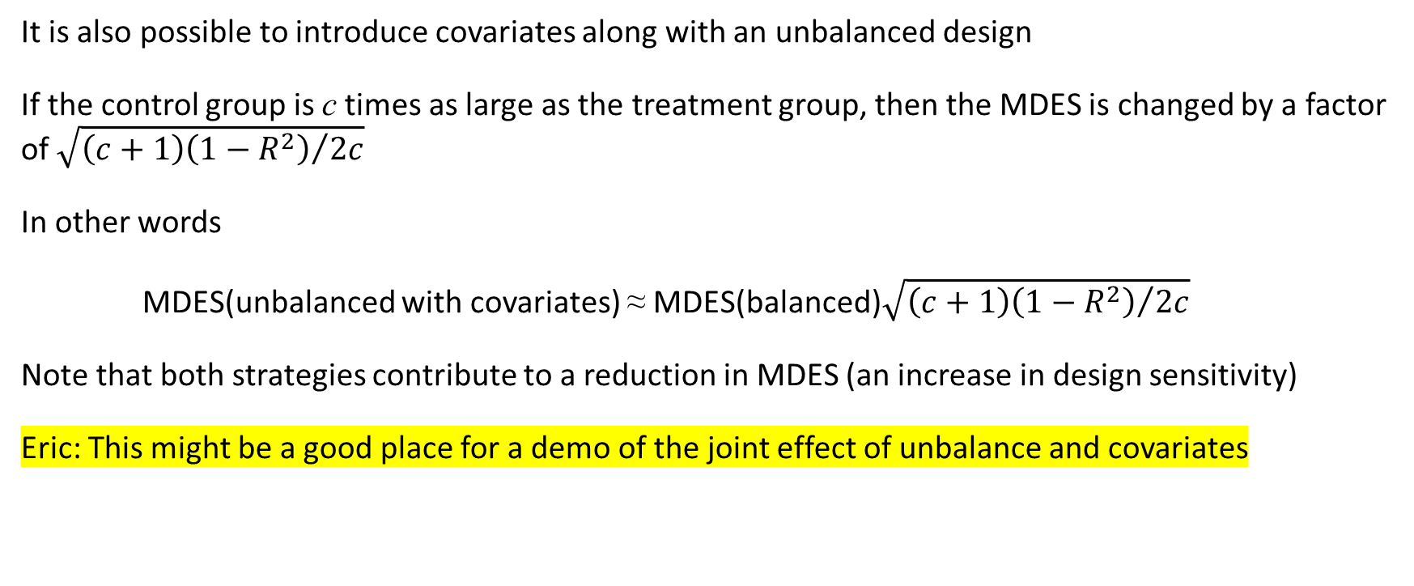
You Can Use Both Covariates and Imbalance
It is also possible to introduce covariates along with an unbalanced design
If the control group is c times as large as the treatment group, then the MDES is changed by a factor of $\sqrt{{\left(c+1\right)\left(1−R^{2}\right)}/{2c}}$
In other words
MDES(unbalanced with covariates) ≈ MDES(balanced)$\sqrt{{\left(c+1\right)\left(1−R^{2}\right)}/{2c}}$
Note that both strategies contribute to a reduction in MDES (an increase in design sensitivity)
Eric: This might be a good place for a demo of the joint effect of unbalance and covariates

